Slide 1
CONTENT MANAGEMENT SYSTEM
By:
Abhishek Hindocha
Aditya Dixit
B Sai Pranav

Slide 2
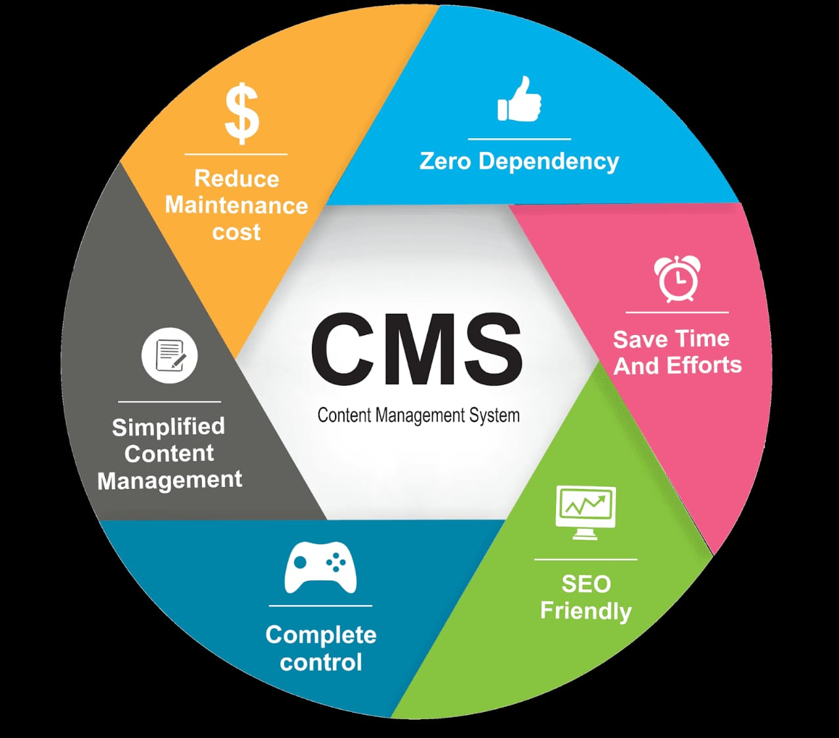
A Content management system is an application that helps you create and manage a website via a human-friendly interface rather than needing to work directly with code. With a content management system, you’re able to ignore the code and focus on the more fun parts of running a website, like creating content.
The aim of our project is to create a brand new platform for content creators to upload their blogs and videos in a way that can be managed in a relatively simple manner, the users can view stats like reach, views, likes and dislikes, comments, subscriber analytics etc.

Slide 3

Table of Contents
SECTION 1 : Problem Statement
SECTION 2 : Requirements
SECTION 3 : Design ( Architecture of the system )
SECTION 4 : Demo of 3 Modules
SECTION 5 : Test Cases

Slide 4

PROBLEM STATEMENT

Slide 5
Problem Statement
In the aftermath of COVID 19 pandemic, there has been a rise in the number of new content creators but these content creators are having a tough time to grow and gain recognition .
Many content creators have a tough time managing their content while creating. Our platform will help them keep track of their content and interpret the feedback in an accurate manner

Slide 6

Requirements

Slide 7
FUNCTIONAL REQUIREMENTS
Requirement (#) | Requirement Specification | Department | Name of Business User | Status
E1FR1 | Allowing the use of multiple payment gateways for payment | Functional Coding Unit | Coder | Completed
E2FR1 | Allowing the customer to enter their details and register to the platform | Interface Coding Unit | Developer | Completed
E2FR2 | Allowing the customer to change their personal details | Functional Coding Unit | Coder | Completed
E3FR1 | A Verification email is sent to user whenever he/she registers for the first time on some software system. | Functional Coding Unit | Coder | Pending
E3FR2 | Provide regular email updates to the customer to inform them of their viewership and stats | Support Team | Customer support executive | Pending
E4FR1 | User can add or edit the content from their account dynamically | Functional Coding Unit | Coder | Completed
E5FR1 | Ability to recommend the customer the content they like according to their interests | Algorithms Unit | Designer | Pending
E6FR1 | As a customer, being able to find the required items with a quick search | Algorithms Unit | Designer | Pending
E7FR1 | The web will have adequate redundancies built-in to the hardware and software architecture to ensure that maintenance requirements or unexpected failures will not take the system completely off-line. | Functional Coding Unit | Coder | Pending
E8FR1 | Monitoring requirements will be developed to ensure uptime and availability of service and analyse server health, server traffic, individual page requests, etc… | Functional Coding Unit | Coder | Pending
Functional Requirements can also be expressed in the form of “user story” which is the smallest unit of work in an agile framework. It’s an end goal, not a feature, expressed from the software user’s perspective.

Slide 8
Non-Functional Requirements Non-Functional Requirements are the constraints or the requirements imposed on the system. They specify the quality attribute of the software. Non-Functional Requirements deal with issues like scalability, maintainability, performance, portability, security, reliability, and many more.
Requirement (#) | Category of NFR | Requirement Specification | Department | Name of Business User | Status
NFR1 | Speed | All pages should load within 3 seconds | Algorithms Unit | Designer | Completed
NFR2 | Performance | Search should bring the results less than 7 seconds | Algorithms Unit | Designer | Completed
NFR3 | Availability | Application should be available for 24x7 | Support team | Technical Support Executive | Pending
NFR4 | Scalability | Registration Service should scale to serve 1000 request per second over 5 minutes timespan | Algorithms Unit | Designer | Pending
NFR5 | Confidentiality | User details must be encrypted | Functional Coding Unit | Coder | Completed
NFR6 | Compliance | Application should be able to adapt to all kinds of OS | Interface coding Unit | Developer | Completed
E1NFR1 | Speed | OTP should be sent for verification within 60 seconds | Functional Coding Unit | Developer | Pending
E1NFR3 | Security | Payment credentials must be protected using various APIs | Functional Coding Unit | Developer | Pending
E1NFR5 | Flexibility | All payment gateways should be supported by the application | Interface coding Unit | Developer | Pending
E4NFR3 | Extensibility | Ordering Service should be extensible to other countries within 2 days | Support team | Technical Support Executive | Pending
E3NFR2 | Interoperability | Application should be able to transfer data between the content creators and the content viewers | Interface coding Unit | Designer | Completed
E6NFR1 | Reliability | Application should be able to run 24X7 smoothly without any unexpected failures | Support team | Technical Support Executive | Pending

Slide 9
INFRASTRUCTURAL REQUIREMENTS
Requirement (#) | Requirement Specification | Department | Name of Business User / Project Team Member | Status
IR1 | Development Machine with 6 GB Ram and 8 Cores | Management | Project Manager | Completed
IR2 | Code Repository | Development Team | Coder | Completed
IR3 | AWS S3 Bucket | Planning | Project Manager | Completed
IR4 | IDE – VSCode | Development Team | Coder | Completed
IR5 | Database – MongoDB Heroku , AWS | Testing Team | Tester | Completed
IR6 | UI – React Native | Development Team | Designer | Completed
IR7 | APIs | Development Team | Designer | Procurement

Slide 10
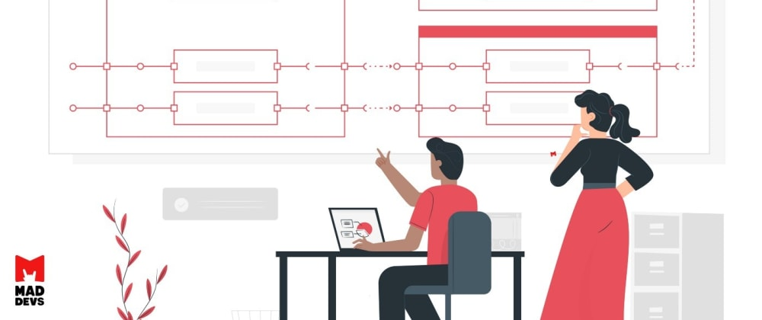
Design(Architecture of System)

Slide 11
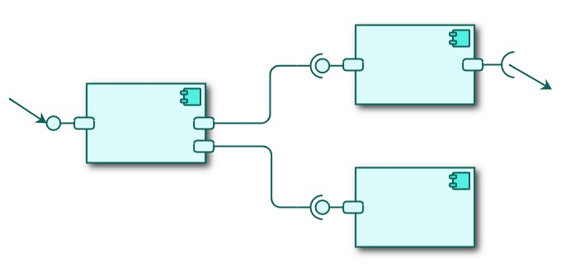
Contents:
USECASE DIAGRAM
ER DIAGRAM
DFD DIAGRAM
CLASS DIAGRAM
COLLABORATION DIAGRAM
SEQUENCE DIAGRAM
DEPLOYMENT DIAGRAM
STATE DIAGRAM

Slide 12
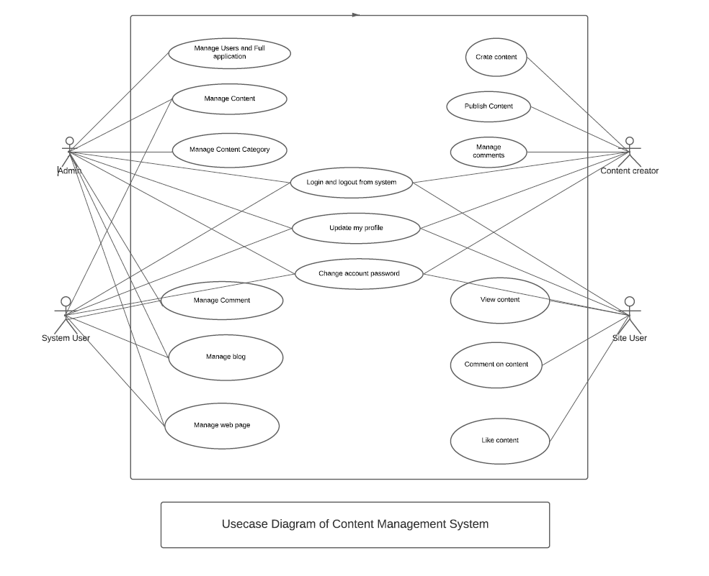
USE CASE DIAGRAM

Slide 13
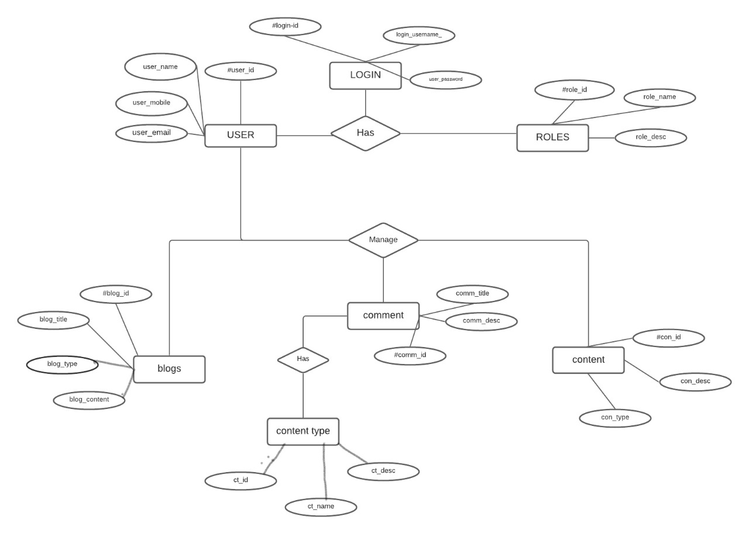
ER DIAGRAM

Slide 14
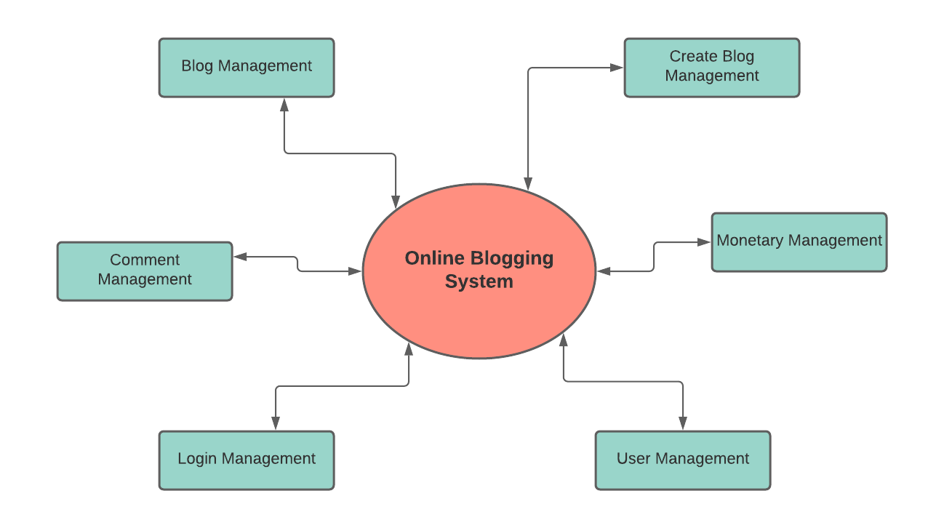
DFD
DIAGRAM
LEVEL 0

Slide 15
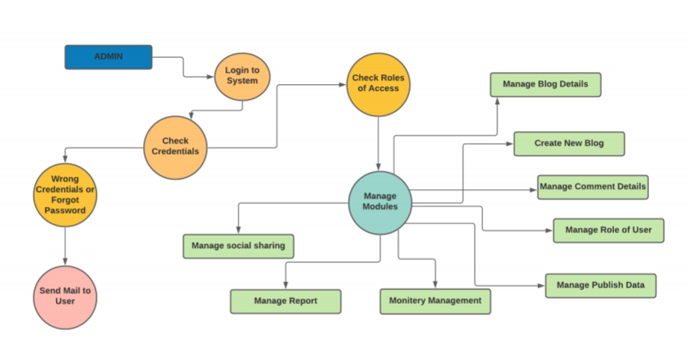
DFD DIAGRAM

Slide 16
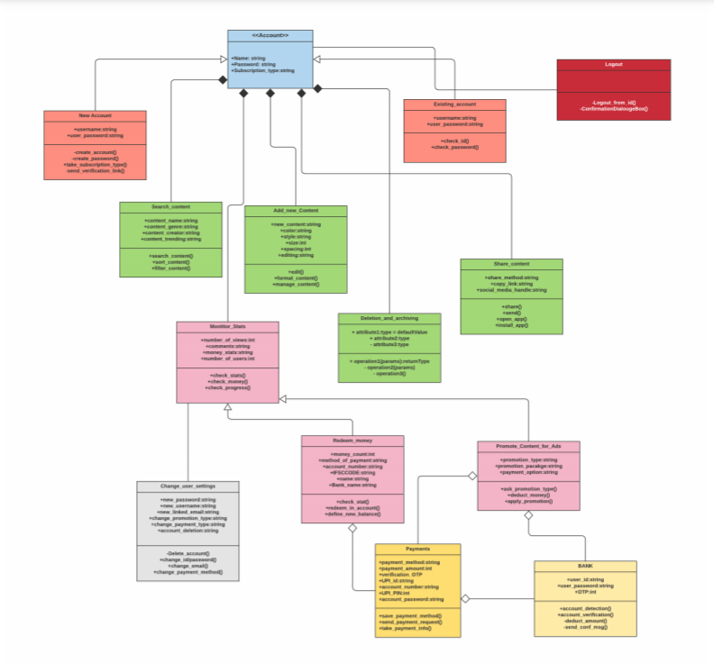
CLASS DIAGRAM

Slide 17
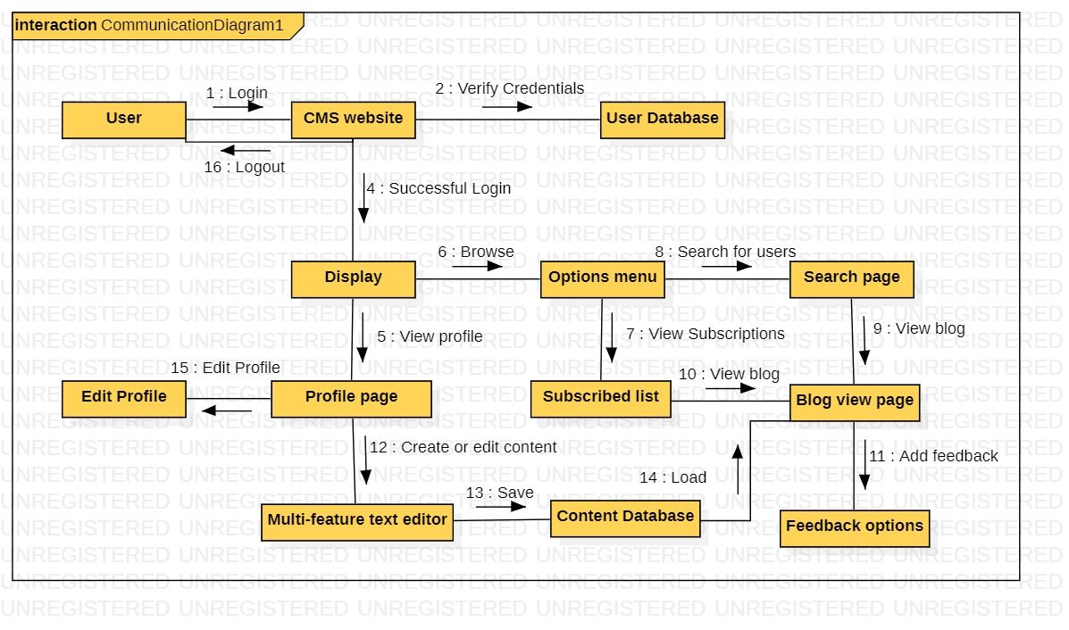
COLLABORATION DIAGRAM

Slide 18
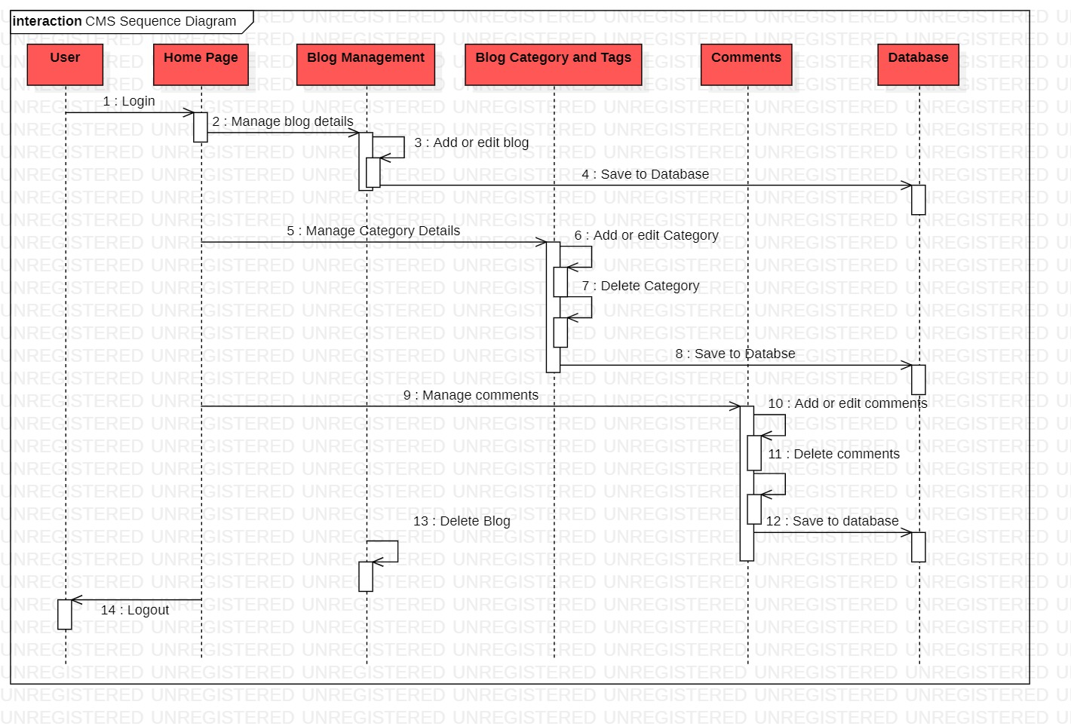
SEQUENCE DIAGRAM

Slide 19
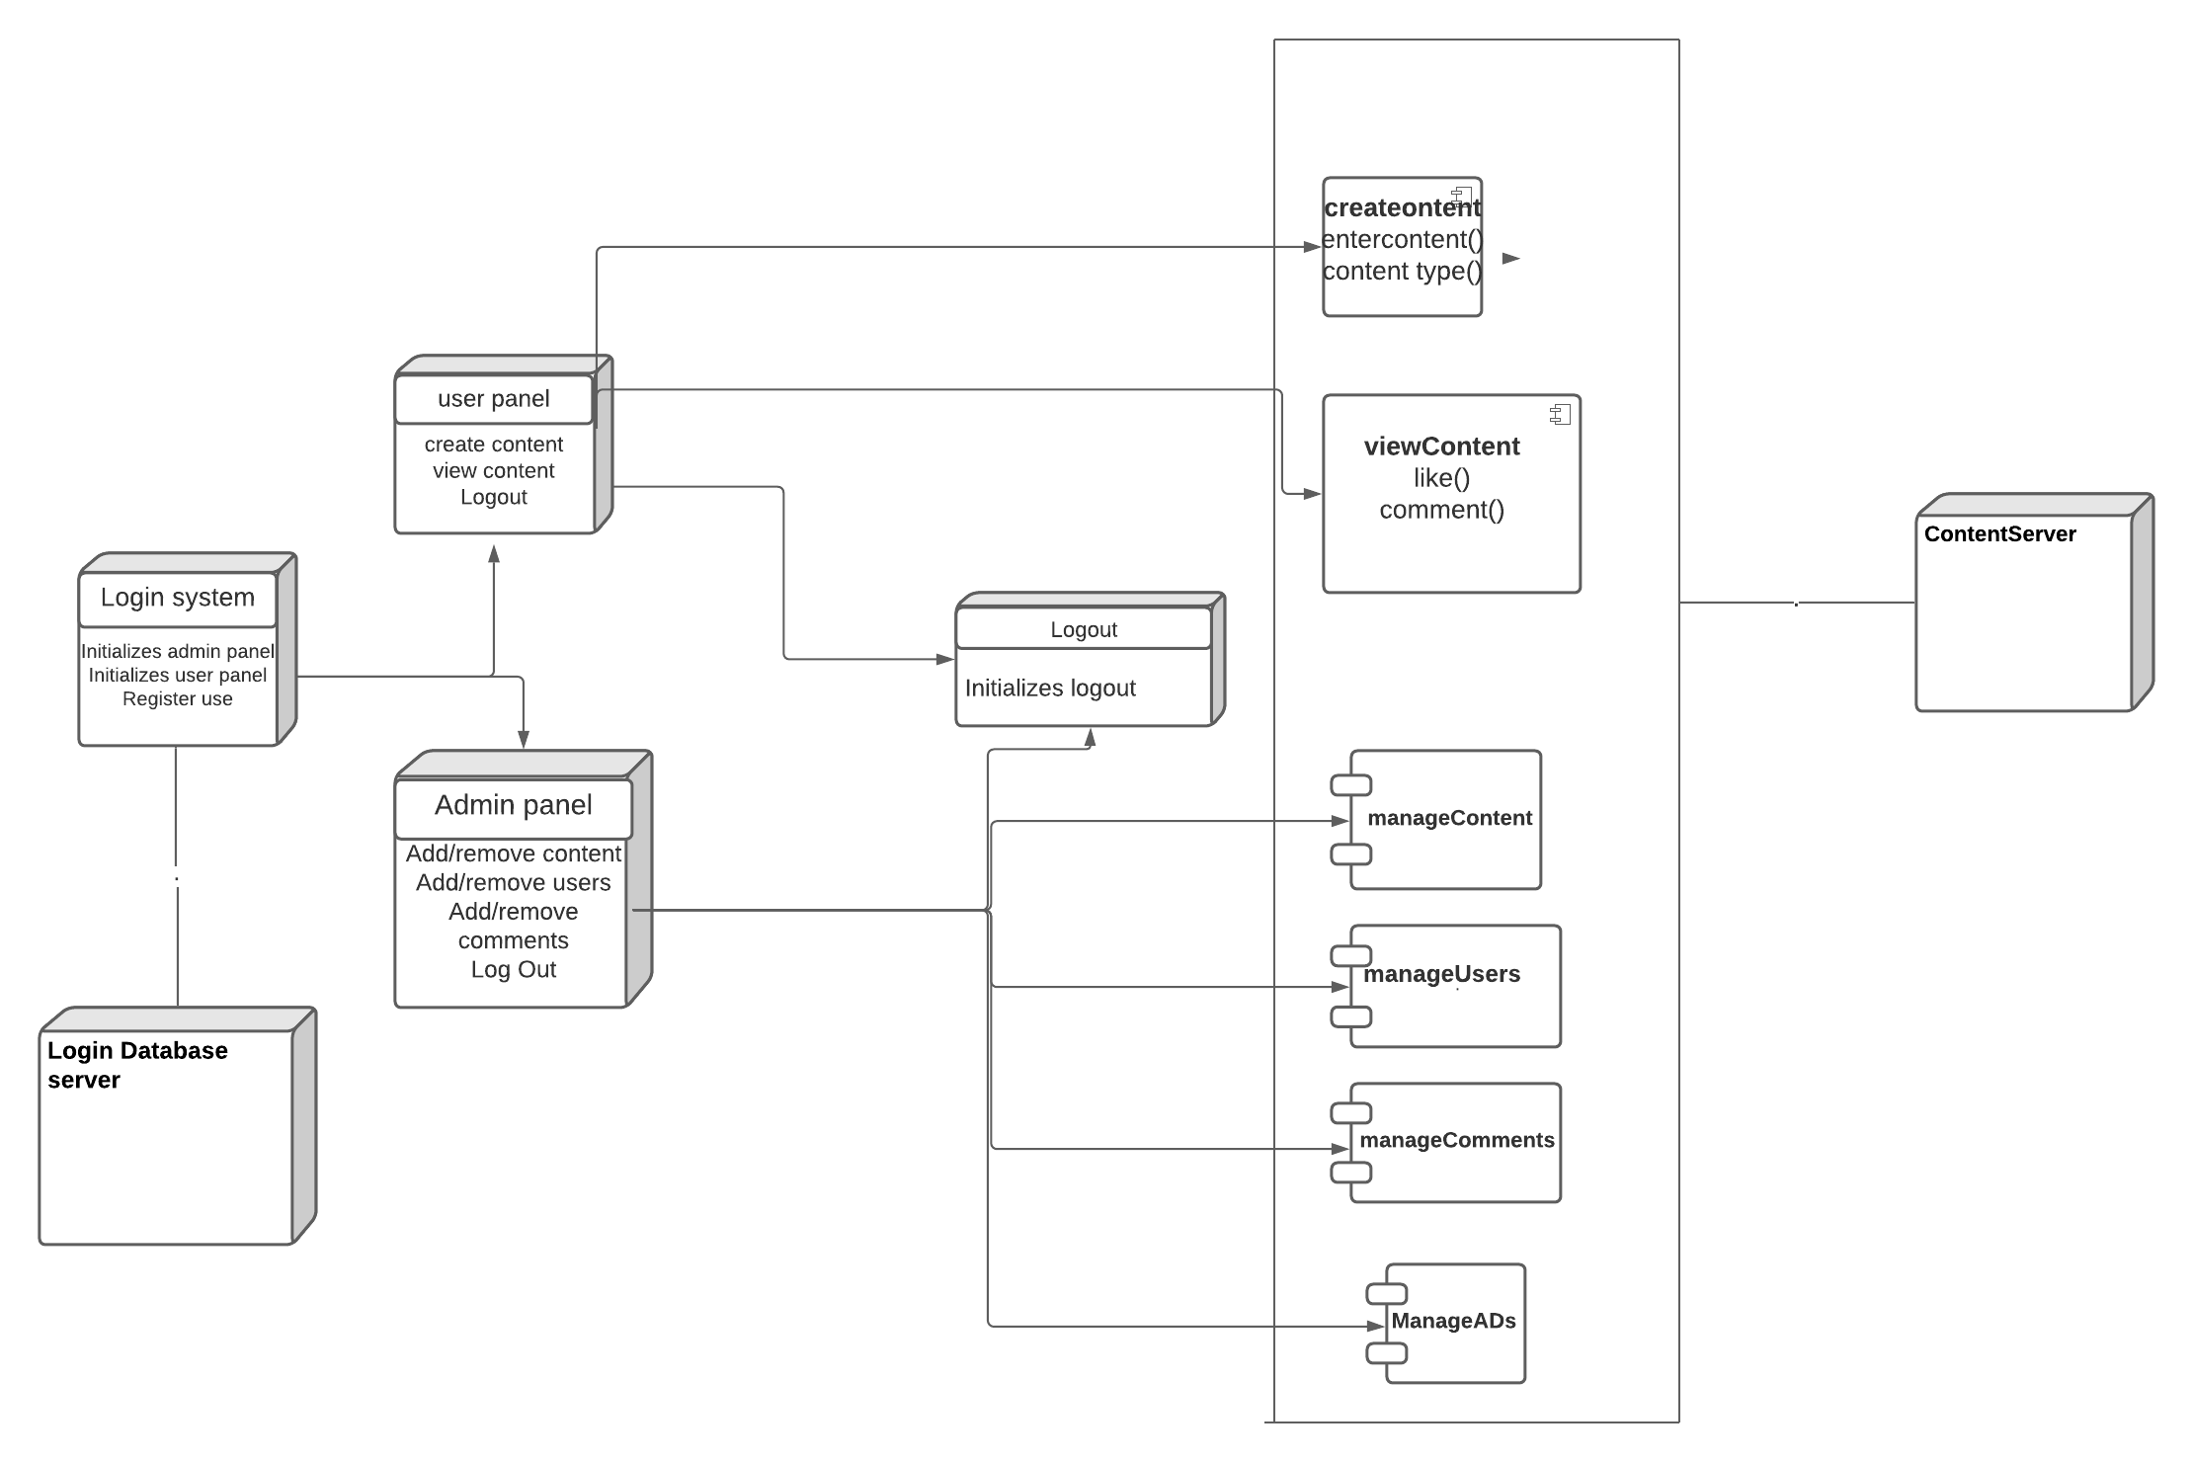
DEPLOYMENT DIAGRAM

Slide 20
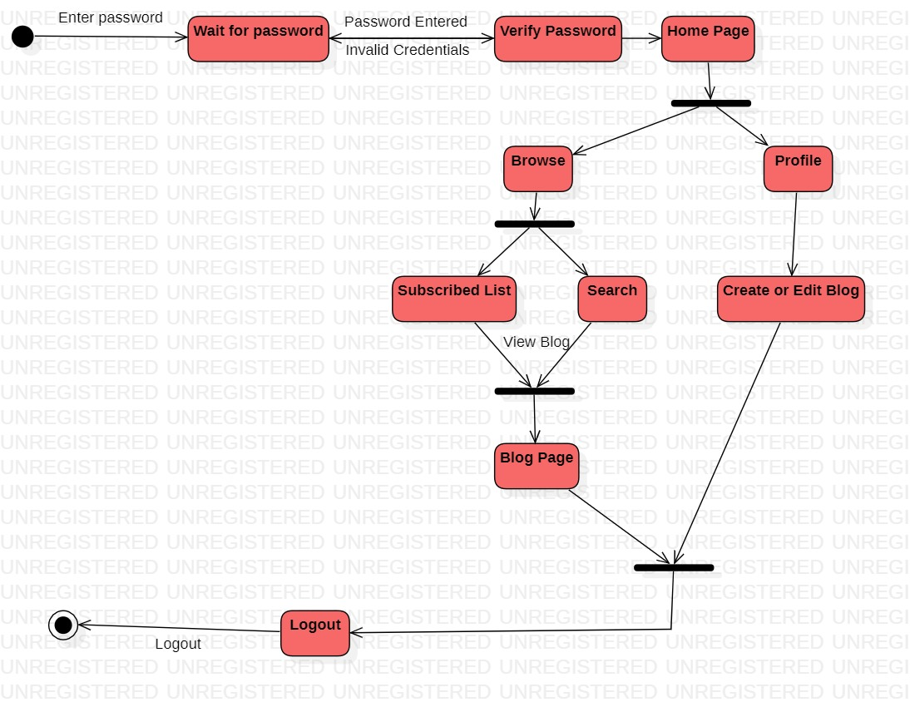
STATE DIAGRAM

Slide 21


Slide 22
MODULE 1

Slide 23
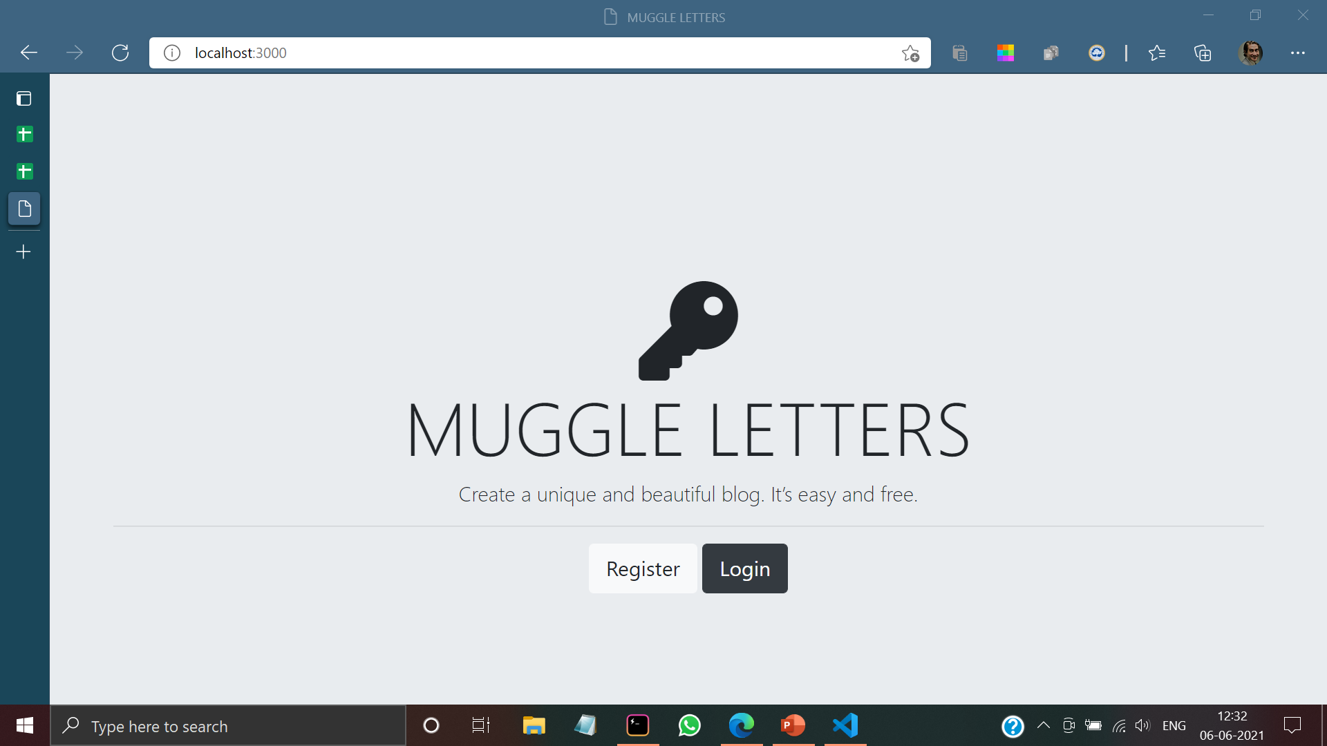

Slide 24
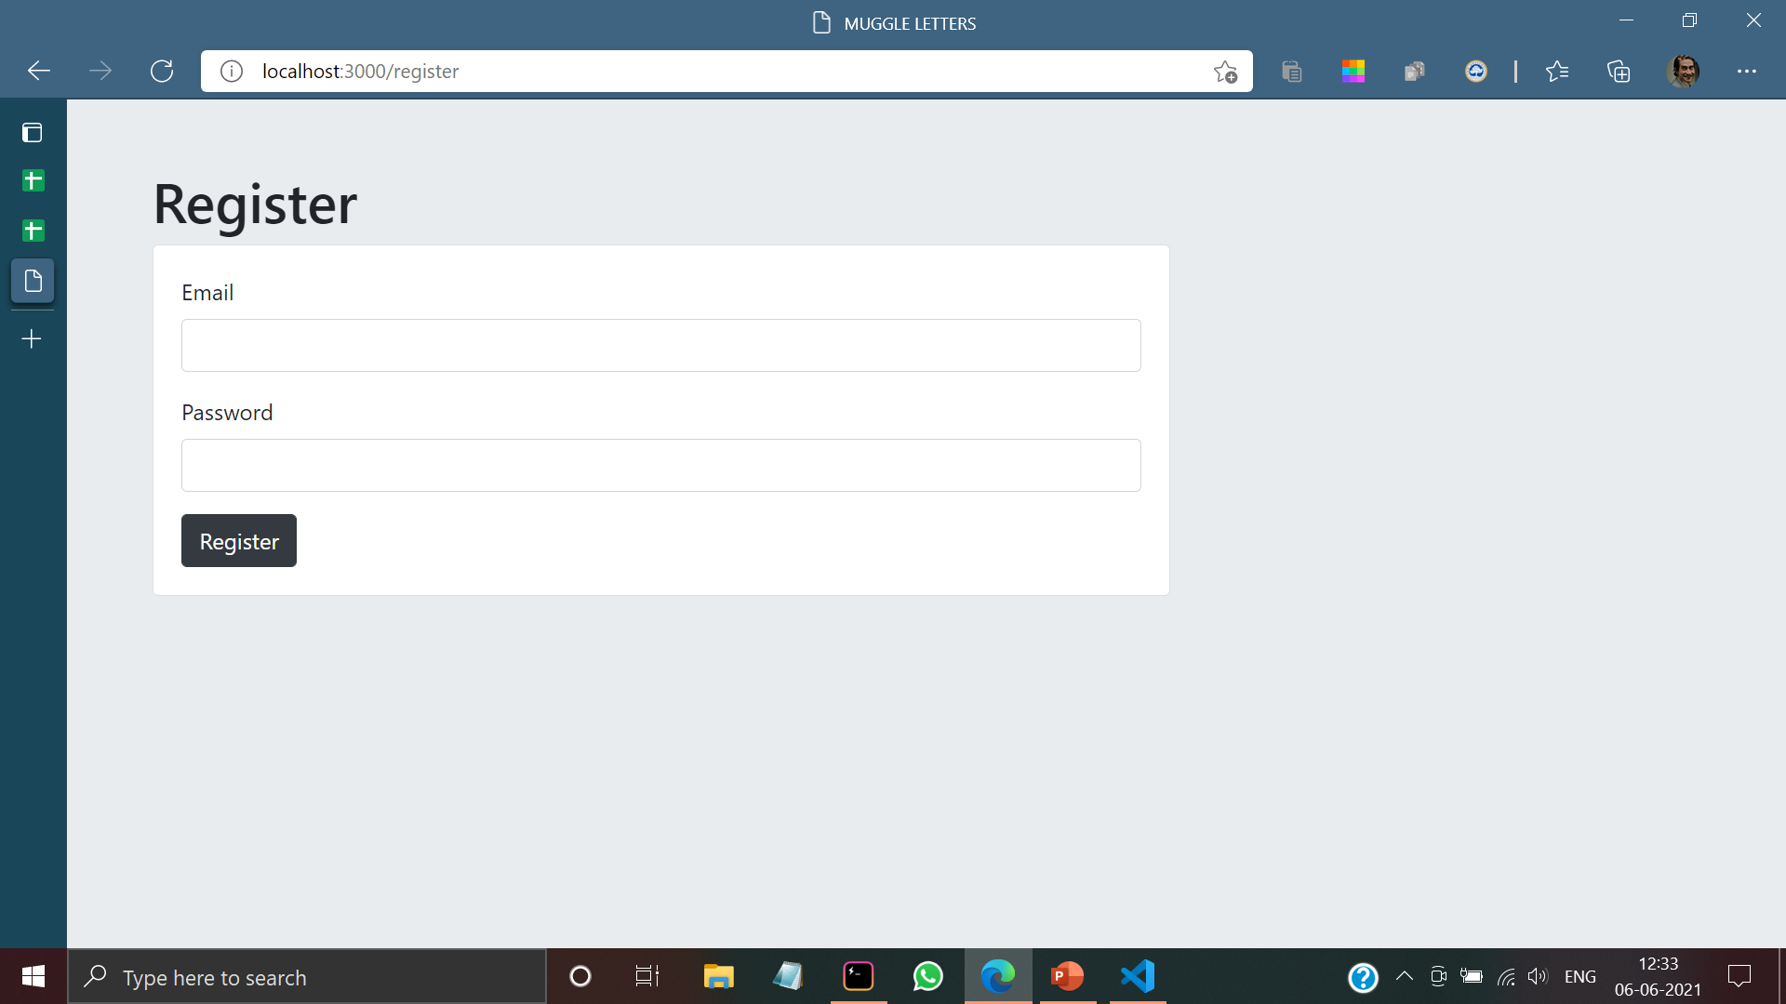

Slide 25


Slide 26
MODULE 2

Slide 27
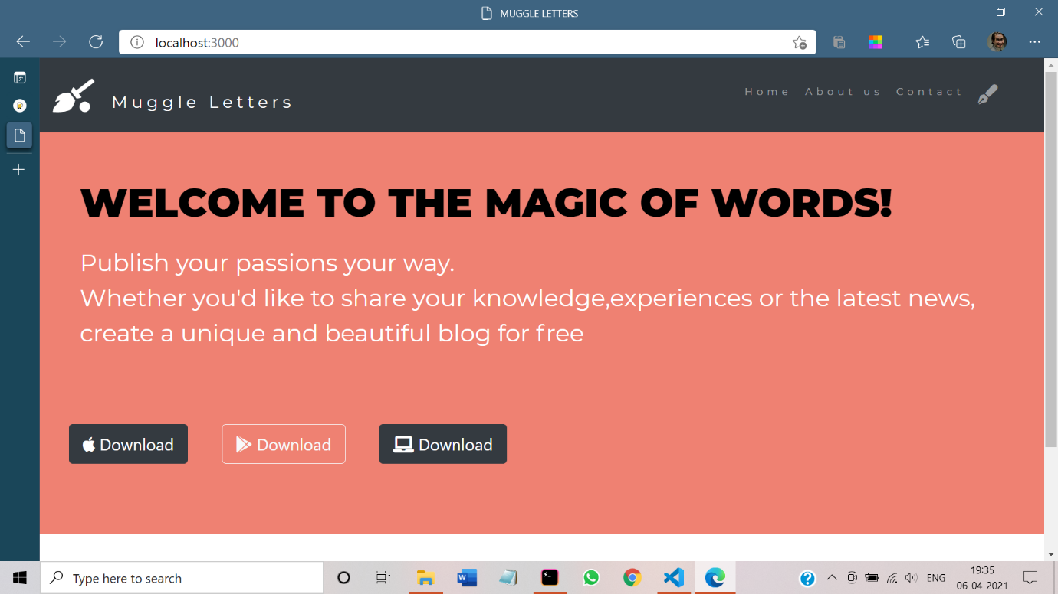

Slide 28
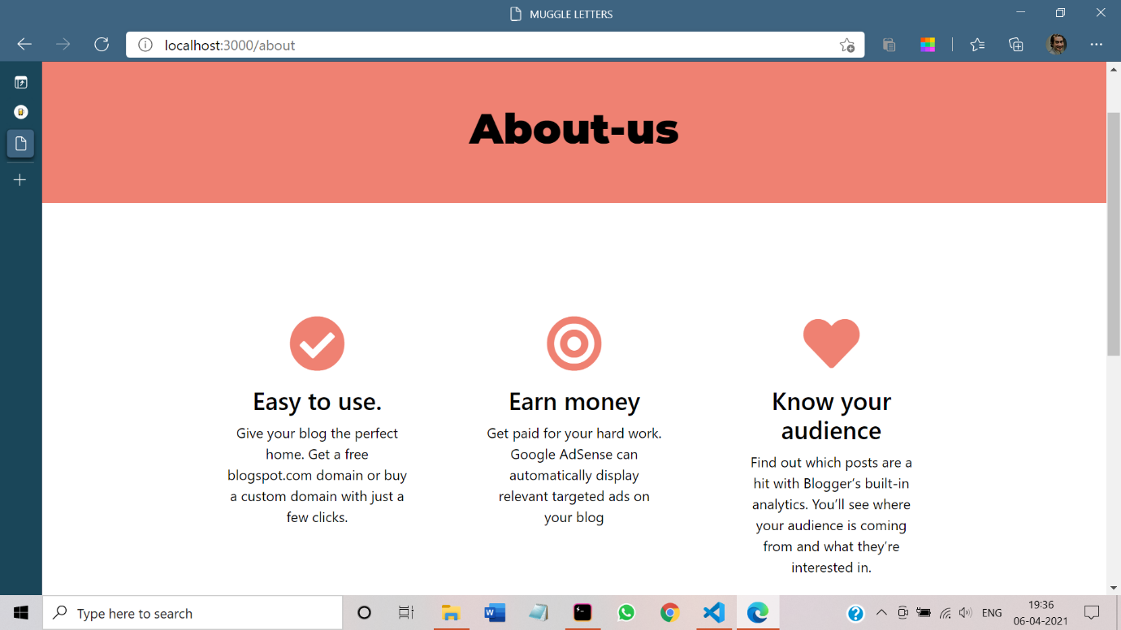

Slide 29
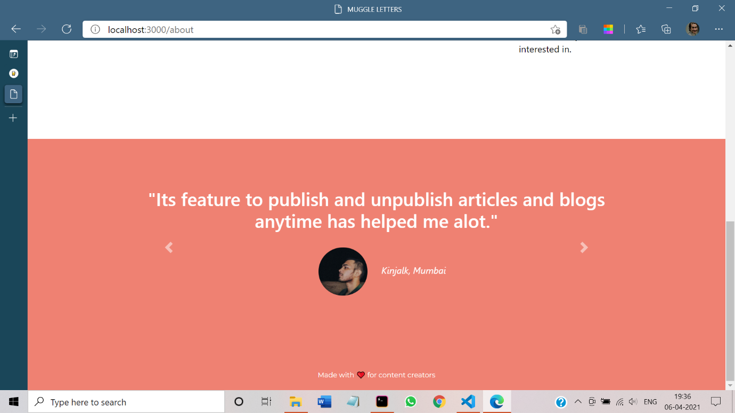

Slide 30
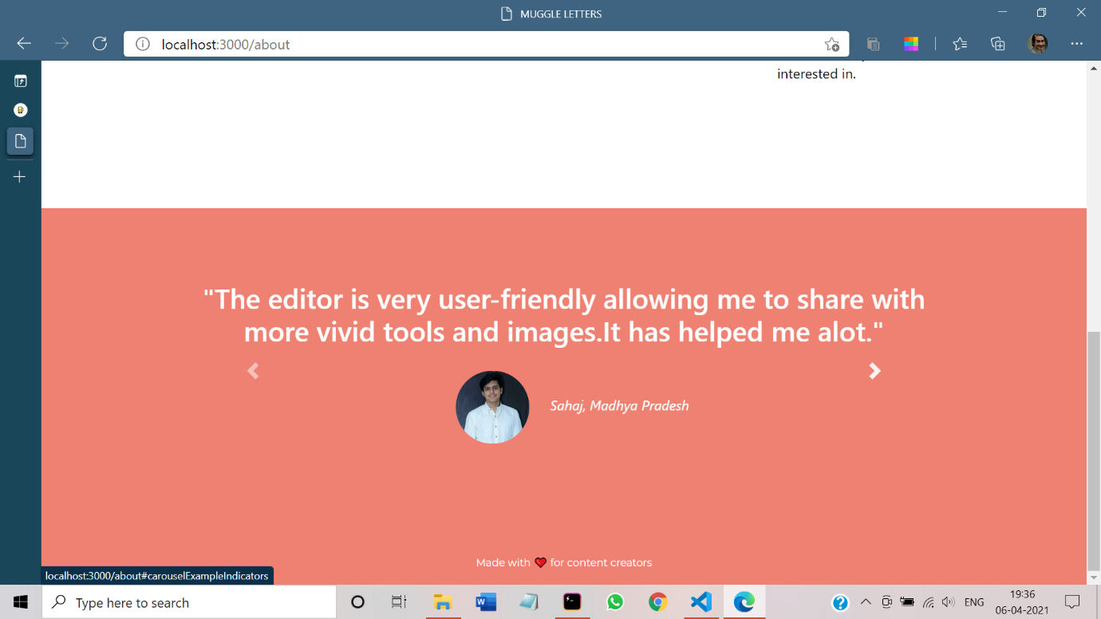

Slide 31
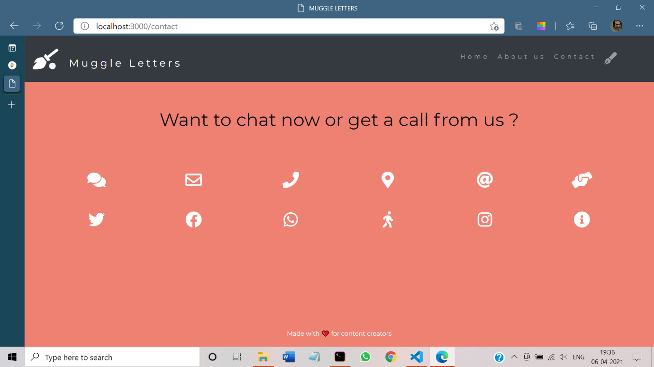

Slide 32
MODULE 3

Slide 33
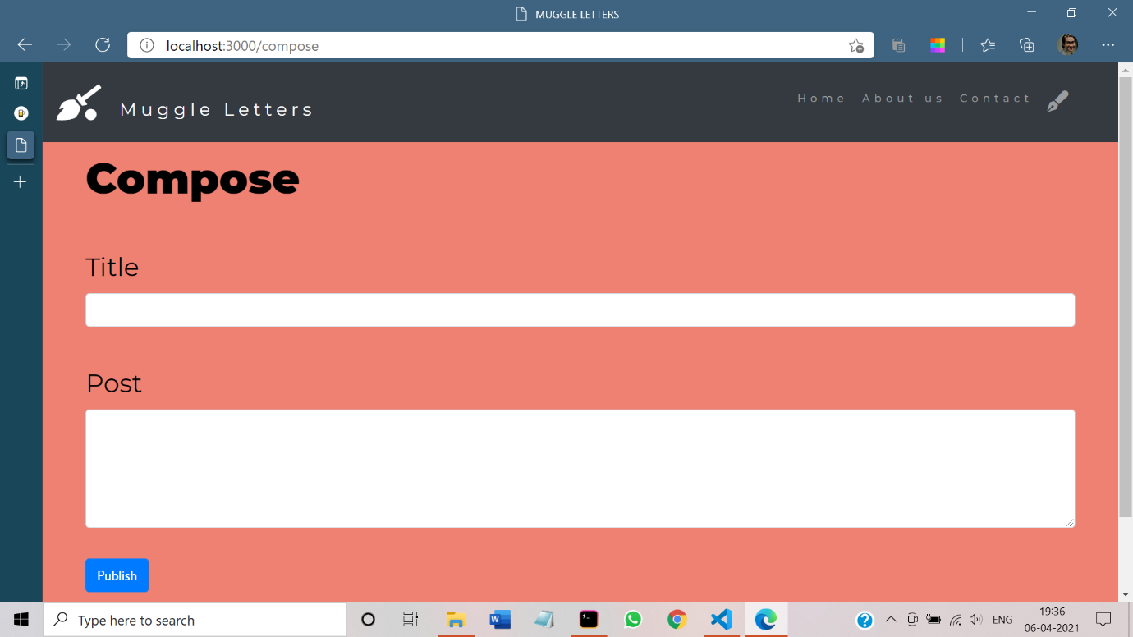

Slide 34
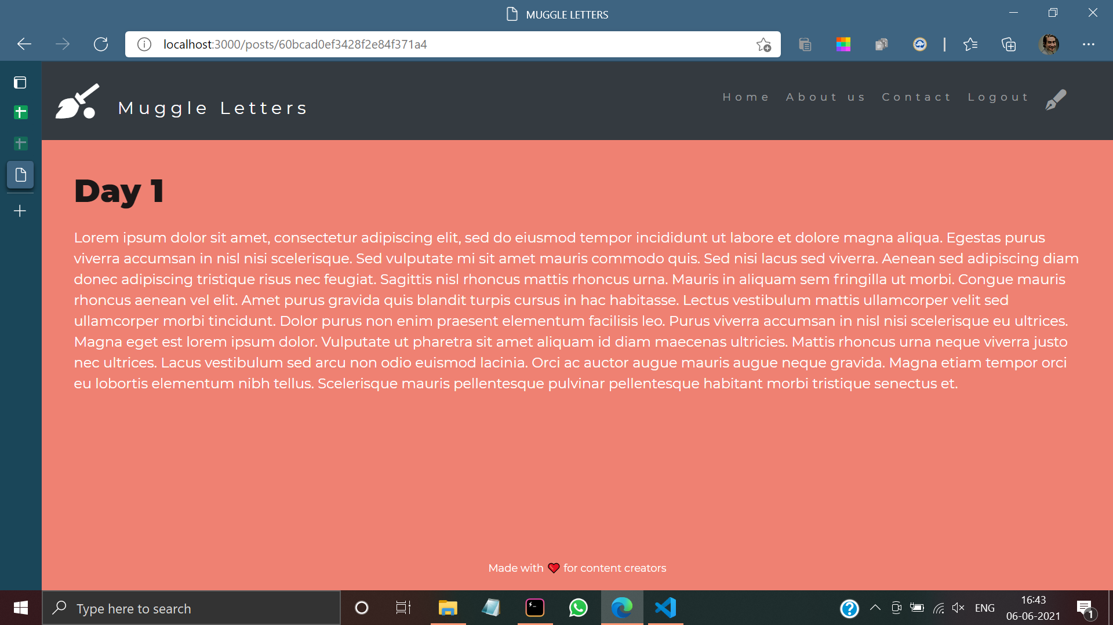

Slide 35

TEST CASES

Slide 36
Test ID (#) | Test Scenario | Test Case | Execution Steps | Expected Outcome | Actual Outcome | Status | Remarks
1 | Adding the user’s details once an account is being created. | Accept the details entered by the user and adding them to database | User clicks on User Registration link Enters the Email id and Password to be set on the text box Click Register button | User should be taken to the home page and alerted with a message “Account successfully created” | User is taken to the home page of the software . | Pass | success
2 | Hiding the password while the user is signing in to the platform | Password must be hidden while typing | User enters the Email Id in the given text box User then moves to the next text box to enter his Password | User should be taken to the home page of the platform. | User is taken to the home page of the platform | Pass | success
3 | Displaying error message when wrong email is being entered | When wrong email id is entered user will be alerted, | 1. User enters the login page. 2. Enters his/her Email ID in the given text box | User should be alerted that the entered Email ID is wrong. | User is alerted that the Email ID is wrong. | Pass | success
FUNCTIONAL TESTCASES

Slide 37
Test ID (#) | Test Scenario | Test Case | Execution Steps | Expected Outcome | Actual Outcome | Status | Remarks
4 | Saving the written blogs to the database and displaying them whenever user wants to view | Blogs written by the user will be saved in the database. | 1.User enters the compose section 2.Enters the title of the blog in the text box given 3.Composes the blog in the given text box. 4.Clicks on the Submit button to post the composed blog. | Blog must be saved in the database and must be visible in the home page | Blog is saved in the database and is displayed in the home page | Pass | Success
5 | Password field takes a minimum of 6 characters, a maximum of 8 characters, numbers (0-9), letters (a-z, A-Z), special characters (all), and cannot be blank. | The Application must take a minimum of 6 charactersand a maximum of 8 characters including all the special characters | User enters the Email Id in the given text box 2.User then moves to the next text box to enter his Password | The application should display an alert saying Password exceeded the limit / password is too short | No message is displayed saying that Password is too short or too long | Fail | Not succesful

Slide 38
Test ID (#) | Test Scenario | Test Case | Execution Steps | Expected Outcome | Actual Outcome | Status | Remarks
1 | Application must be accessible on all types of devices | Application must be compatible to all versions of Windows and Mac | Application will be opened on various versions of Windows and Mac to check the app’s Performance | App must function Smoothly on all versions of Windows and Mac | Application functioned smoothly on all the devices | Pass | Success
2 | All web images should have alt tags | In case of a problem while loading the images an alternative text must be displayed | 1.Path to the image is wrongly specified such that problem will occur in loading the picture 2.By using alt tag in the code, an alternate text will be displayed | Whenever there was a problem in loading images , alternate text must be displayed | Alternate text was displayed when the images weren’t loaded | Pass | Success
NON FUNCTIONAL
TESTCASES

Slide 39
Test ID (#) | Test Scenario | Test Case | Execution Steps | Expected Outcome | Actual Outcome | Status | Remarks
4 | Ensuring that a database replicates to a standby instance , and that in the event of failure the standby instance can takeover with no loss of service | Maintaining a secondary database as a standby such that data won’t be lost in case of any failures | 1.We try to simulate a real life scenario where the database gets deleted. 2.We check if the data stored is still available | In the event of failure, the standby database must be able to takeover without any loss of service | In the event of failure, data is lost as there is no standby database. | Fail | Can be resolved with more time and resources
5 | Must withstand and recover from a Denial-of-service(Dos or DDos) attack, where external systems attempt to flood the bandwidth or resources | Must be able to defend external systems which tries to flood the bandwidth or resources or target firewall. | Implemented by hitting the target resource such as a web server with too many requests at the same time. | System must be stable and reliable even when under extremely heavy load conditons | As the amount of load increased, the application couldn’t cope with the extreme demand | Fail | Not successful as there’s no firewall.

Slide 40








Thank You ☺

